Slide 1

Krackit
Group G3
College Assistance and Preparation
Crack any entrance exam with Krackit

Slide 2
Group Leader | Jay Chevli | 202312049
Group Member | Vishal Thadani | 202312097
Group Member | Shivam Javiya | 202312029
Group Member | Parth Vaghasiya | 202312045

Slide 3
Assignments of tasks to each team member
 | Documentation | Modules
Jay Chevli 202312049 (Group Leader) | User Story SRS DFD UML DB Design | Admin Panel Alumni Panel Degree Institute | Query Mailer OTP PDF | Review Google Sign up Razorpay
Vishal Thadani 202312097 (Group Member) | User Story SRS DFD UML DB Design | Main Website UI Sign in UI Sign up UI Search Bar Algorithm | Career Assessment Test Recommendation Purchased Mock Tests | Mock Test Set Live Mock Test Result

Slide 4
Assignments of tasks to each team member
 | Documentation | Modules
Shivam Javiya 202312029 (Group Member) | User Story SRS DFD UML DB Design | Entrance Exam Mock Test Details Razorpay | Buy Mock Test Contact
Parth Vaghasiya 202312097 (Group Member) | User Story SRS DFD UML | Back end: Login Sign up Sign in | Back end: Forgot Password OTP Reset Password

Slide 5
Objectives
This website is primarily made for students. Students, who are in Higher Secondary can browse to our website and checkout career options of their interest.
Also, they can browse through all the institutes and degree information from one website.
Foster interaction and engagement among students, alumni, and administrators.
Here, Student can buy mock tests and prepare for their entrance exam.

Slide 6
Milestones
Project Planning:
Define project objectives, scope, and requirements.
Assign roles and responsibilities to team members.
Set up communication channels and project management tools.
Development Phase:
Developed Database
Design and develop the frontend and backend of the website.
Conduct testing to ensure functionality and usability.
Content Creation:
Gather and create content for the website, including text, images, and multimedia.
Ensure content aligns with project objectives and target audience.

Slide 7
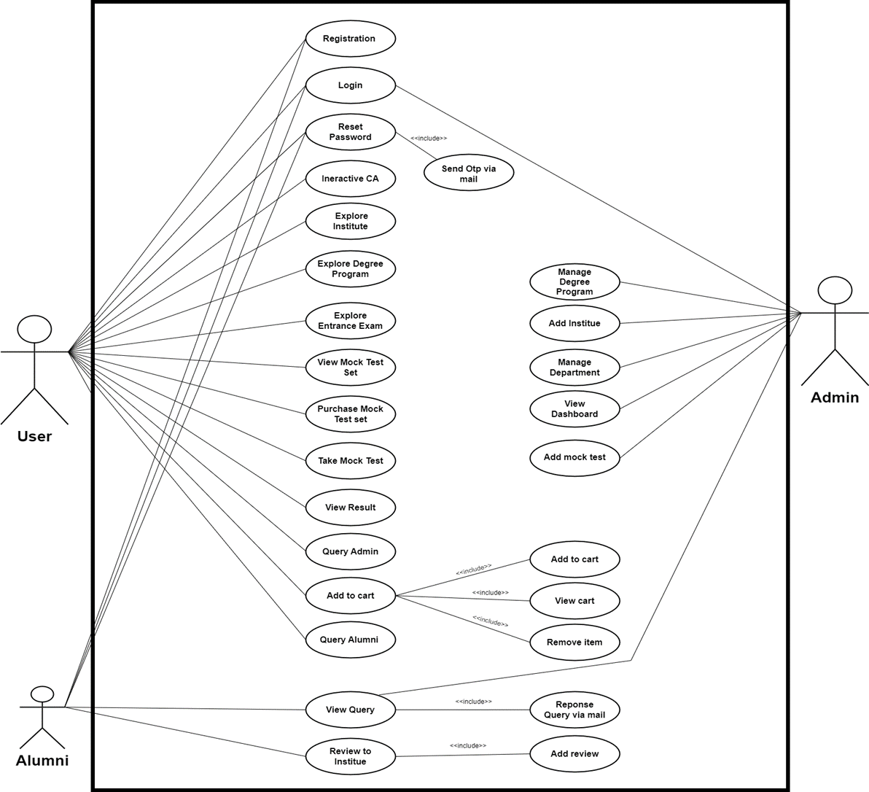
Use case

Slide 8
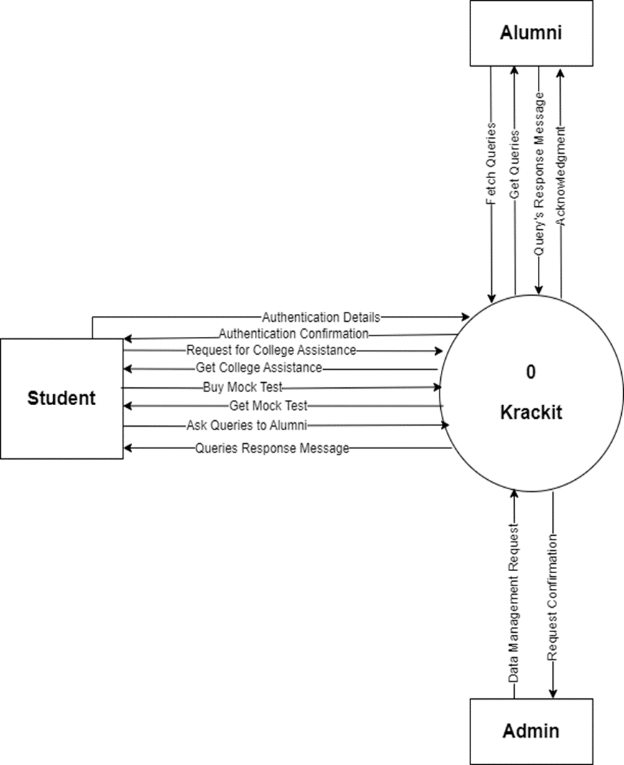
Level 0 DFD

Slide 9
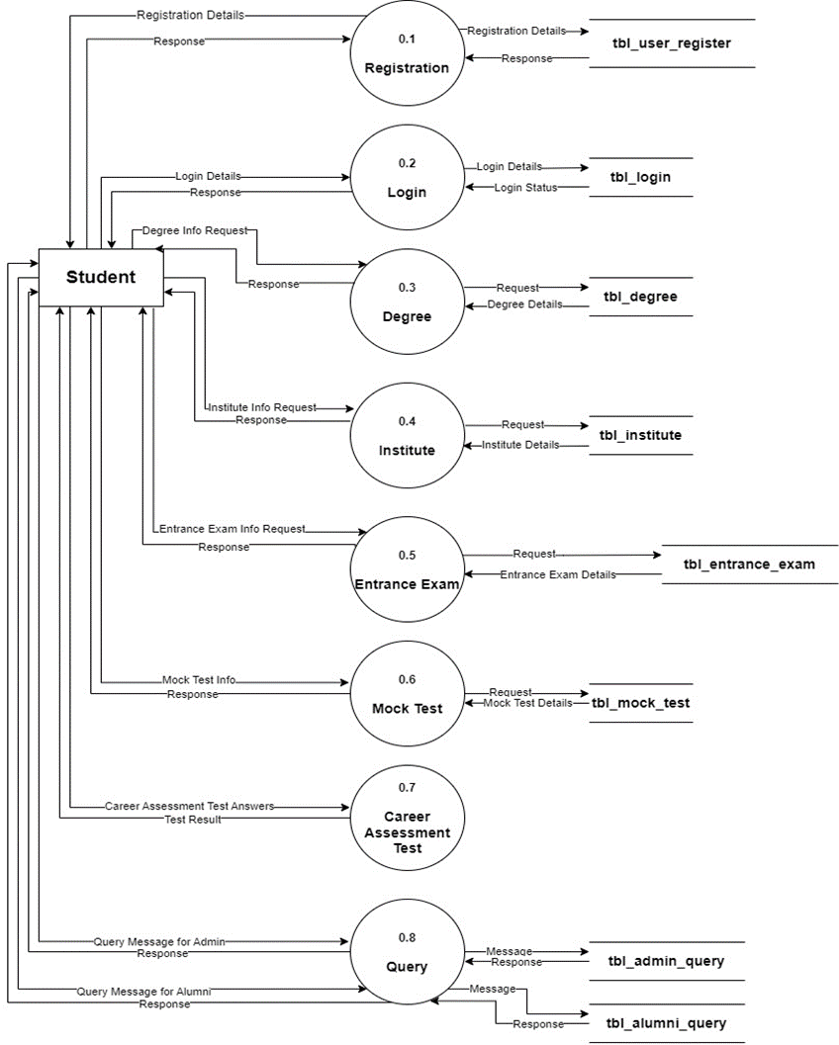
Level 1 DFD

Slide 10
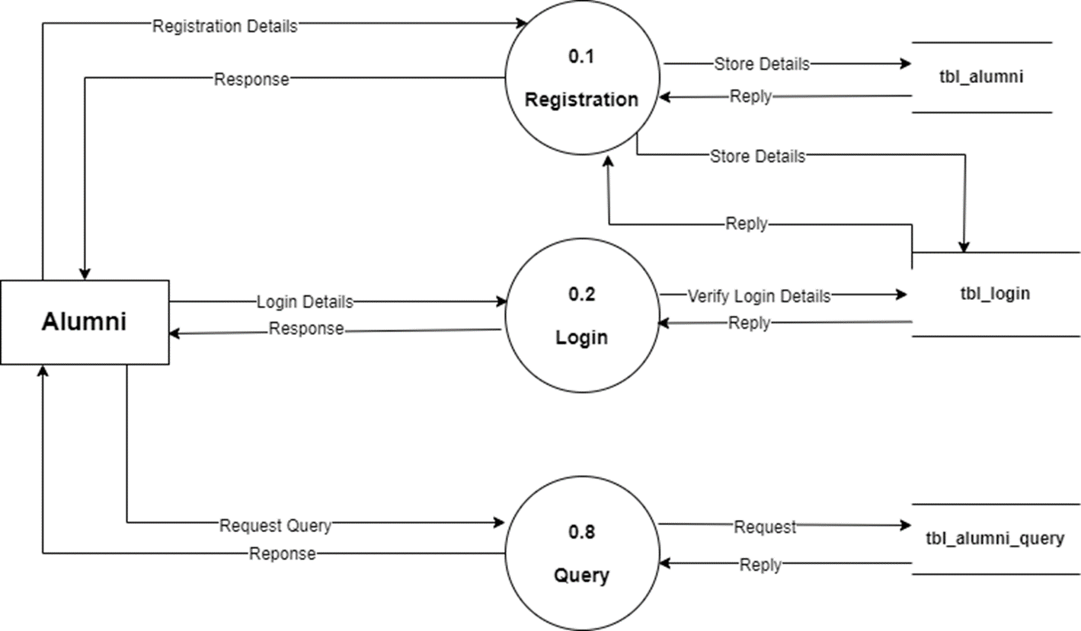
Level 1 DFD

Slide 11
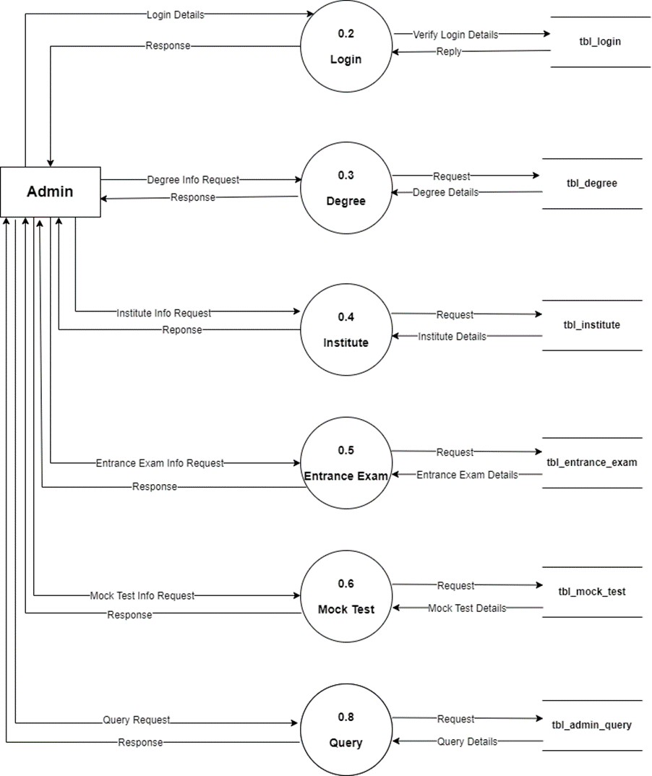
Level 1 DFD

Slide 12
Screenshot

Slide 13
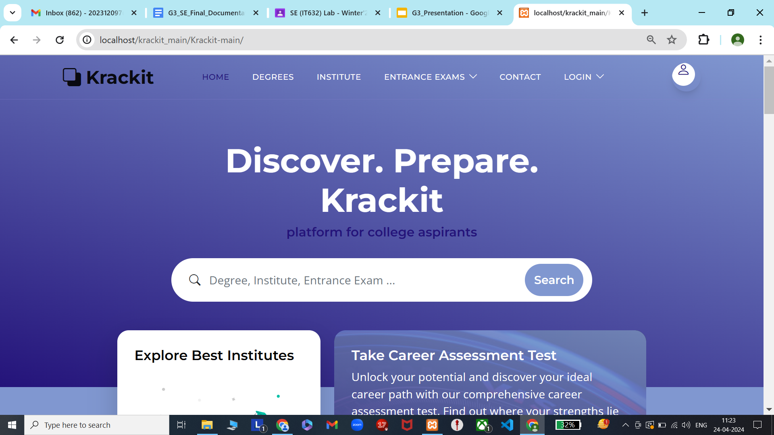

Slide 14
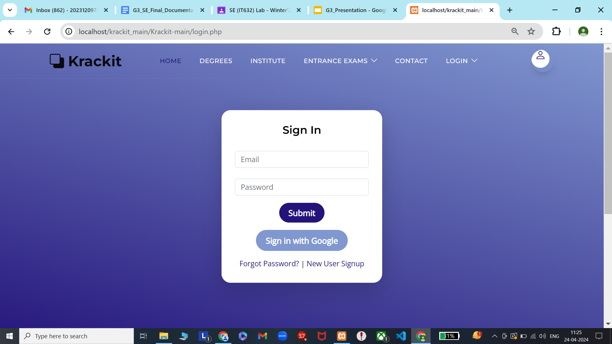

Slide 15
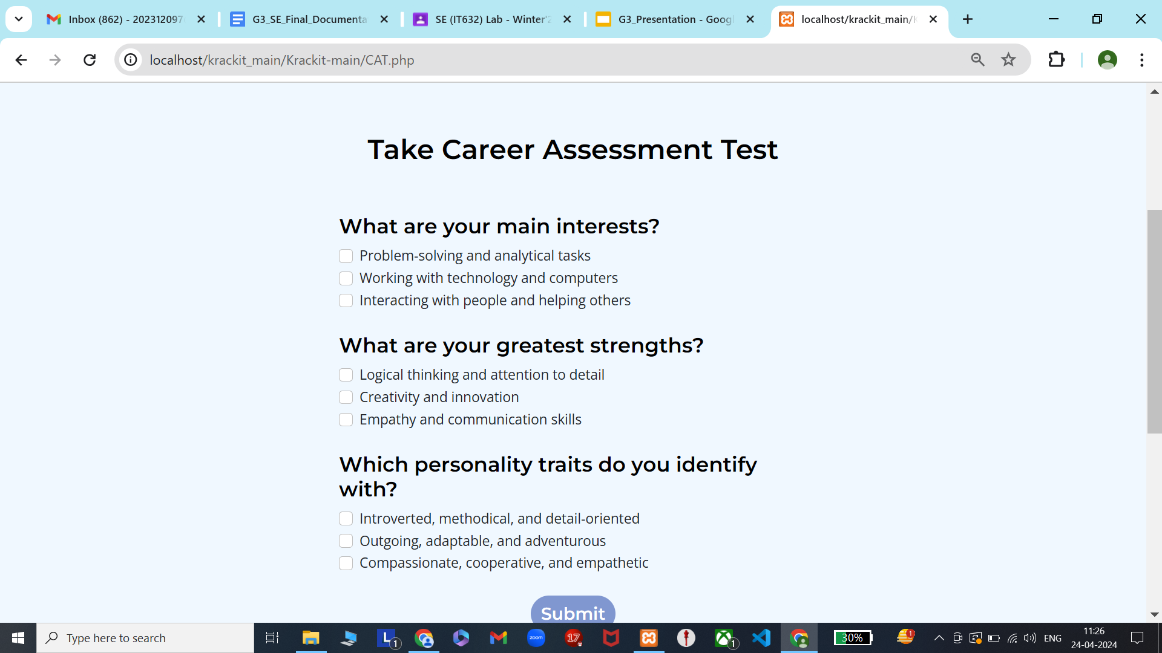

Slide 16
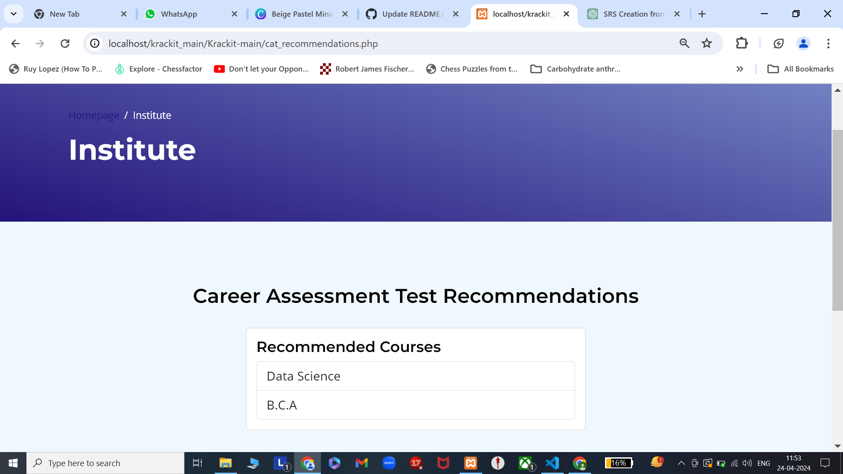

Slide 17
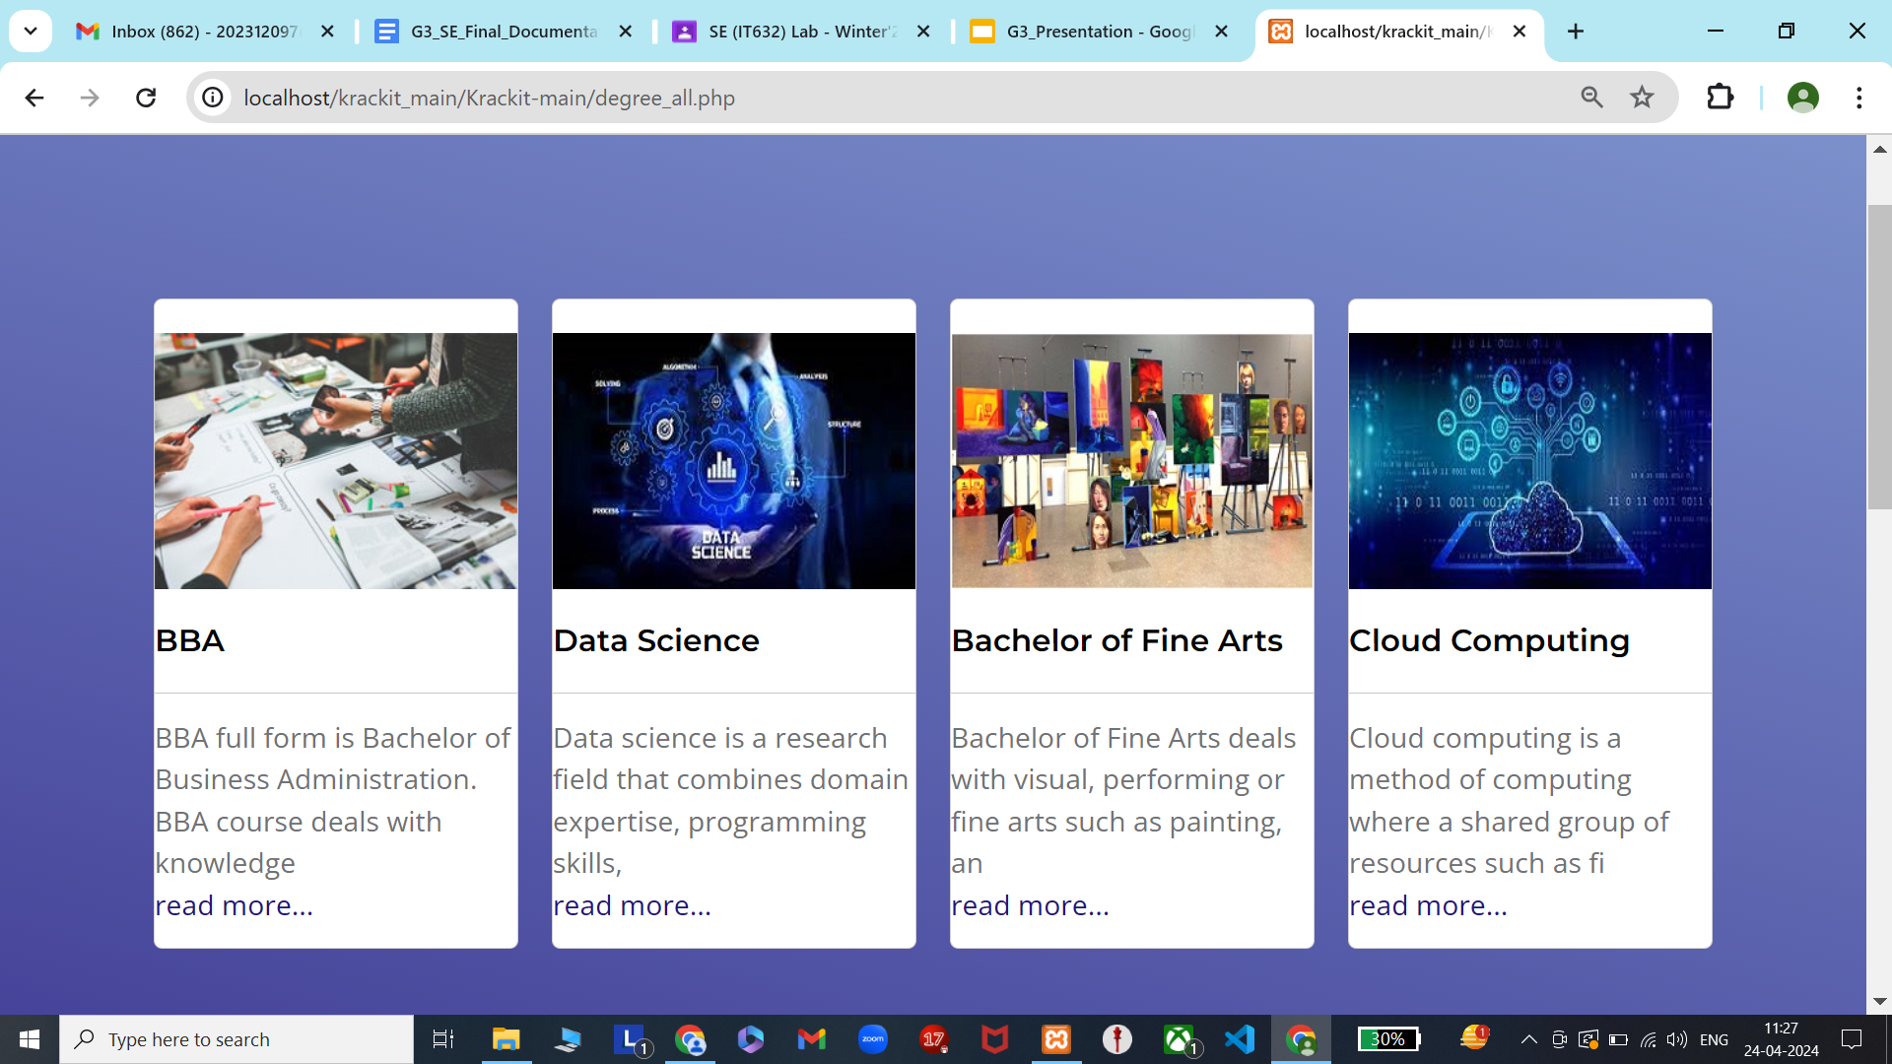

Slide 18
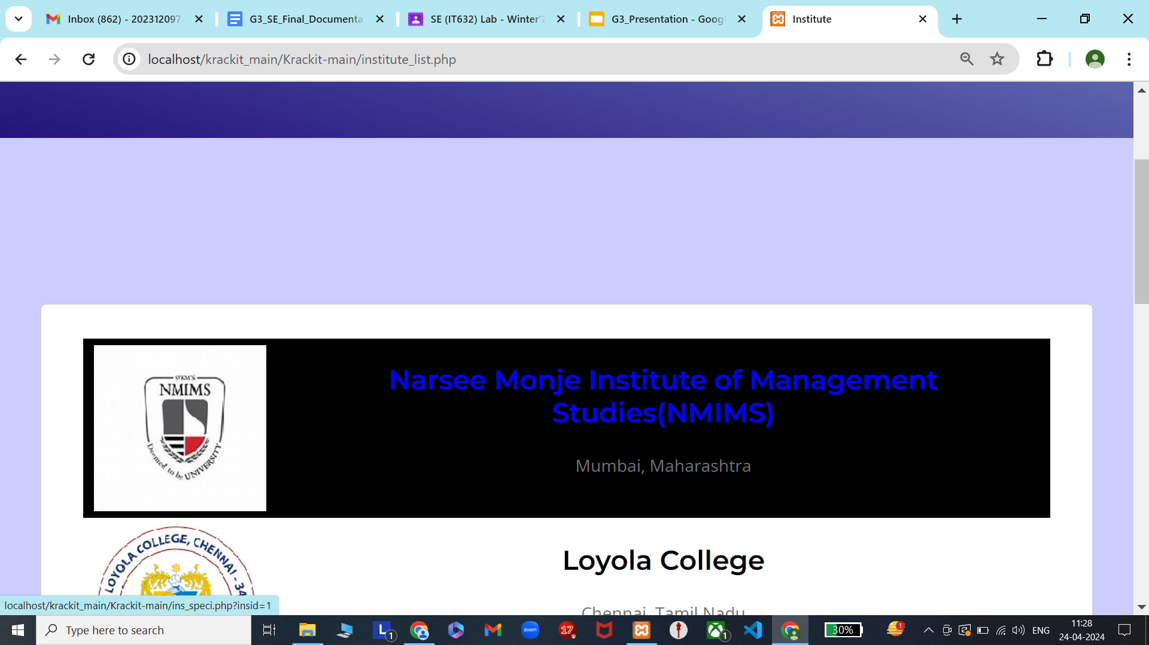

Slide 19
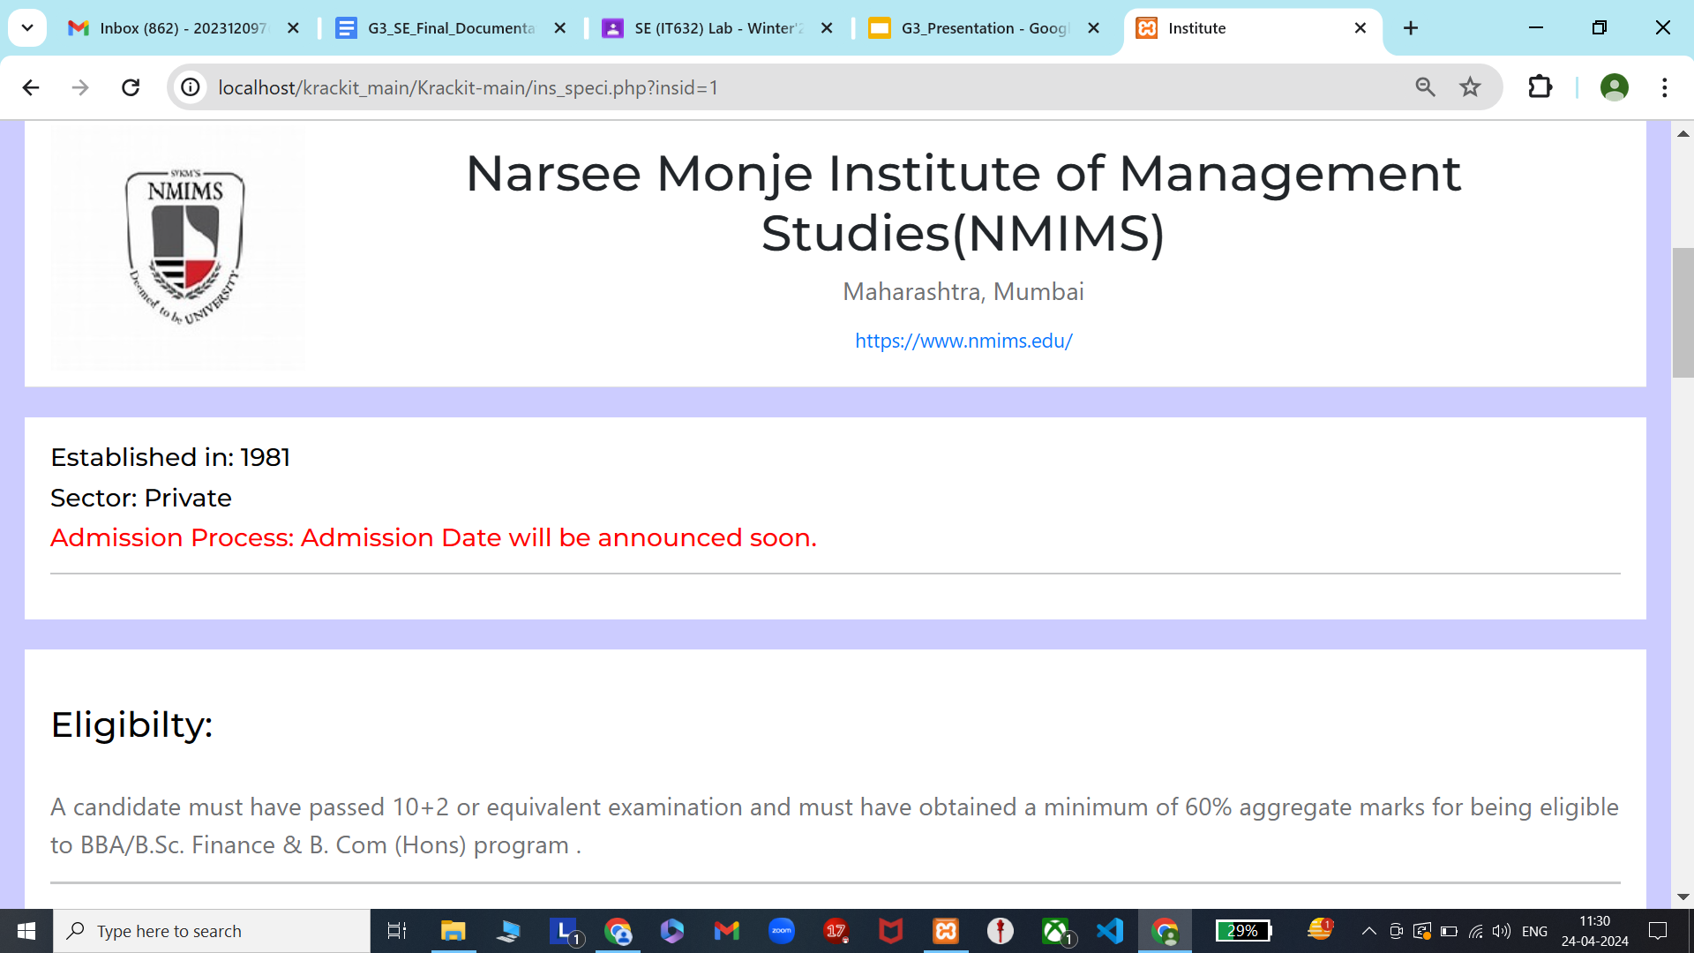

Slide 20
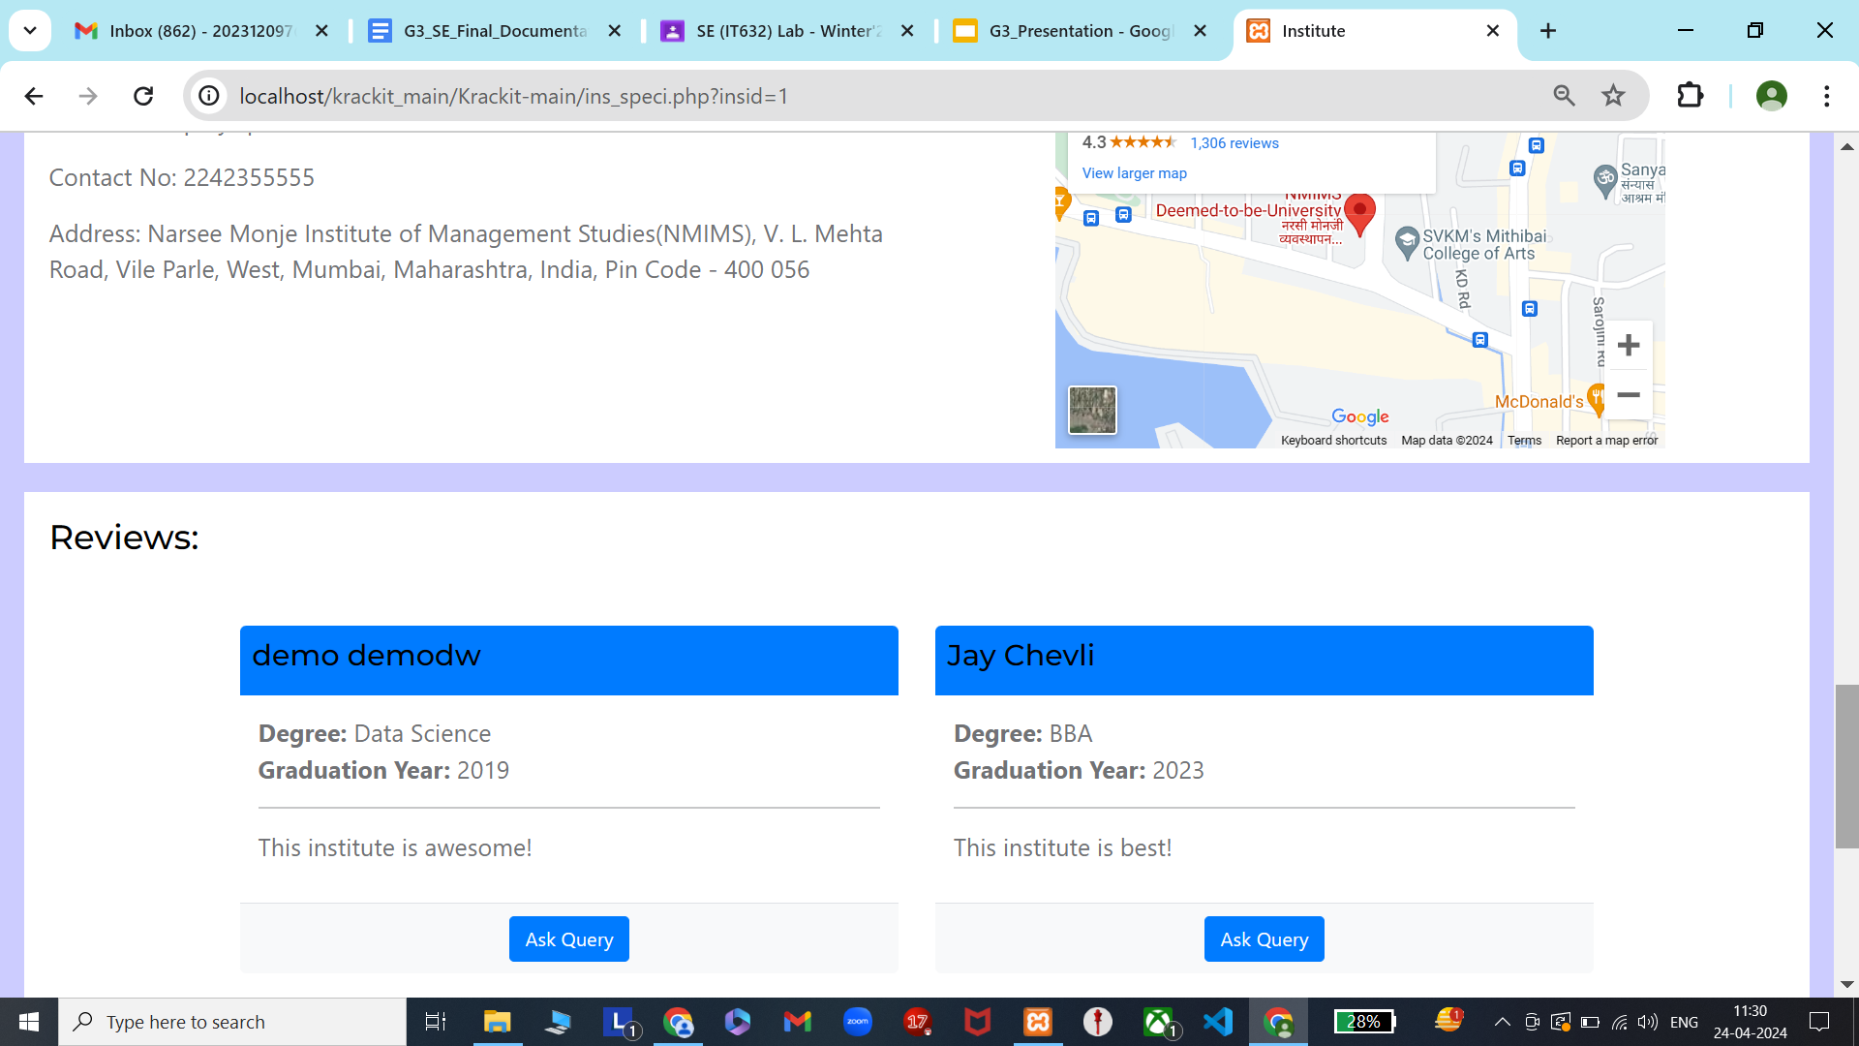

Slide 21
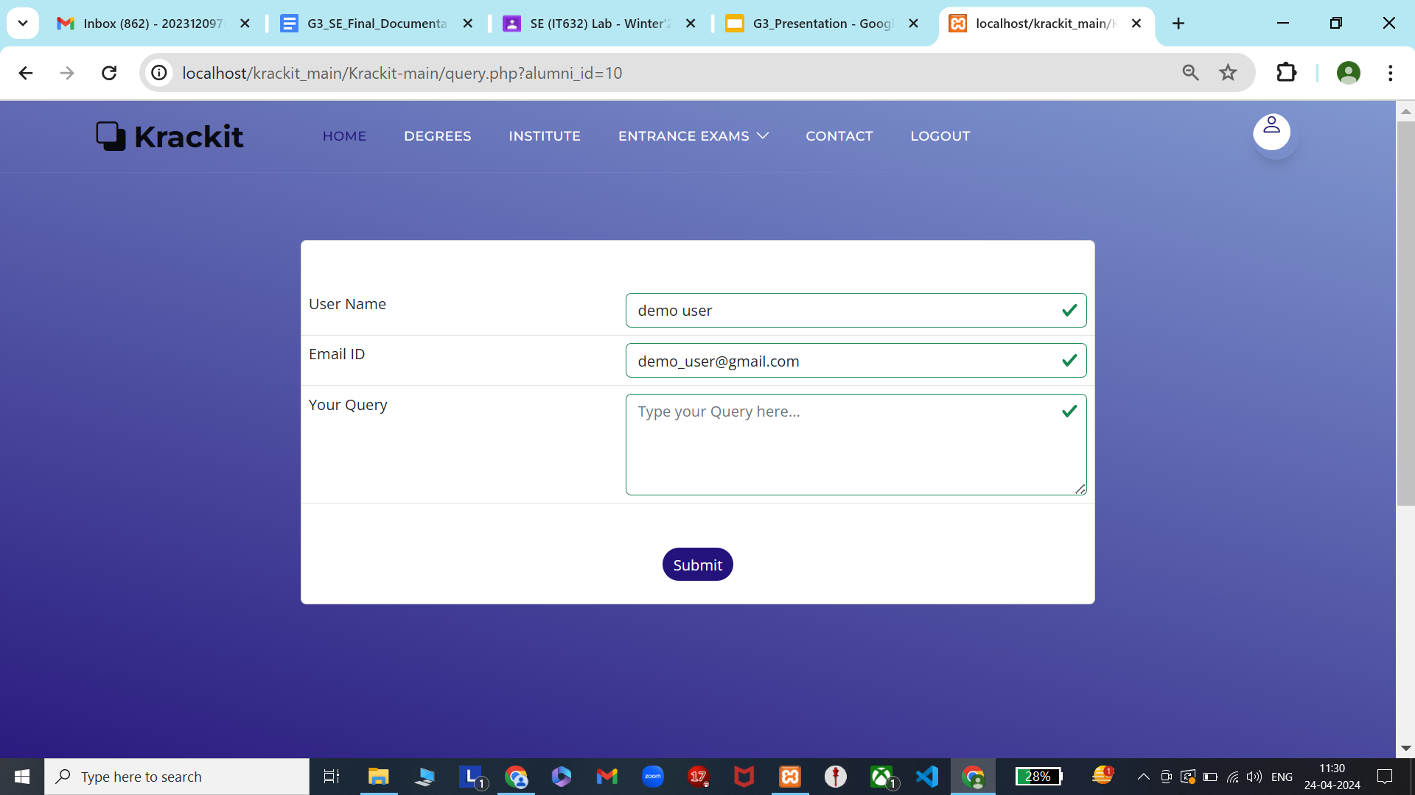

Slide 22
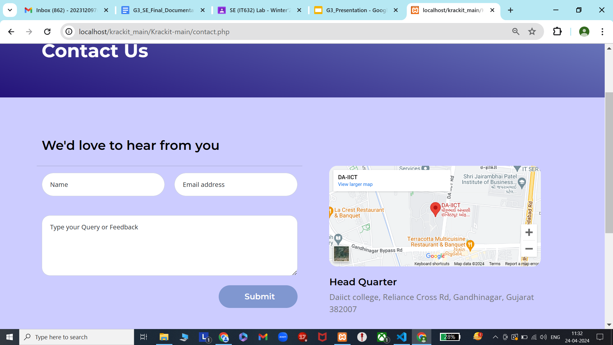

Slide 23
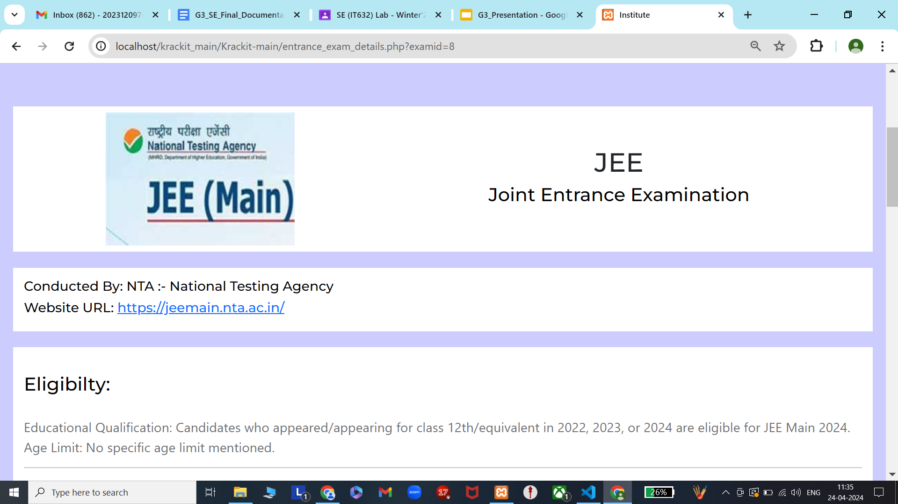

Slide 24
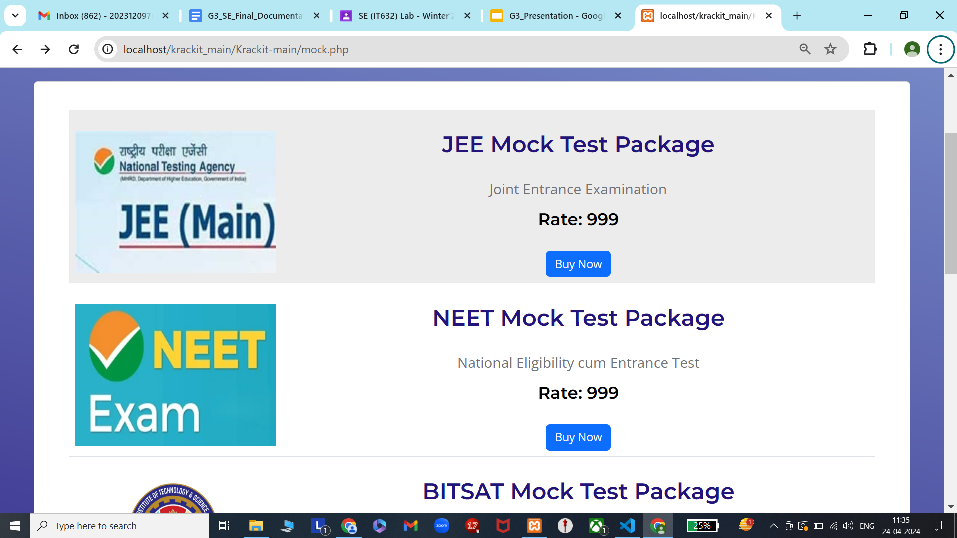

Slide 25
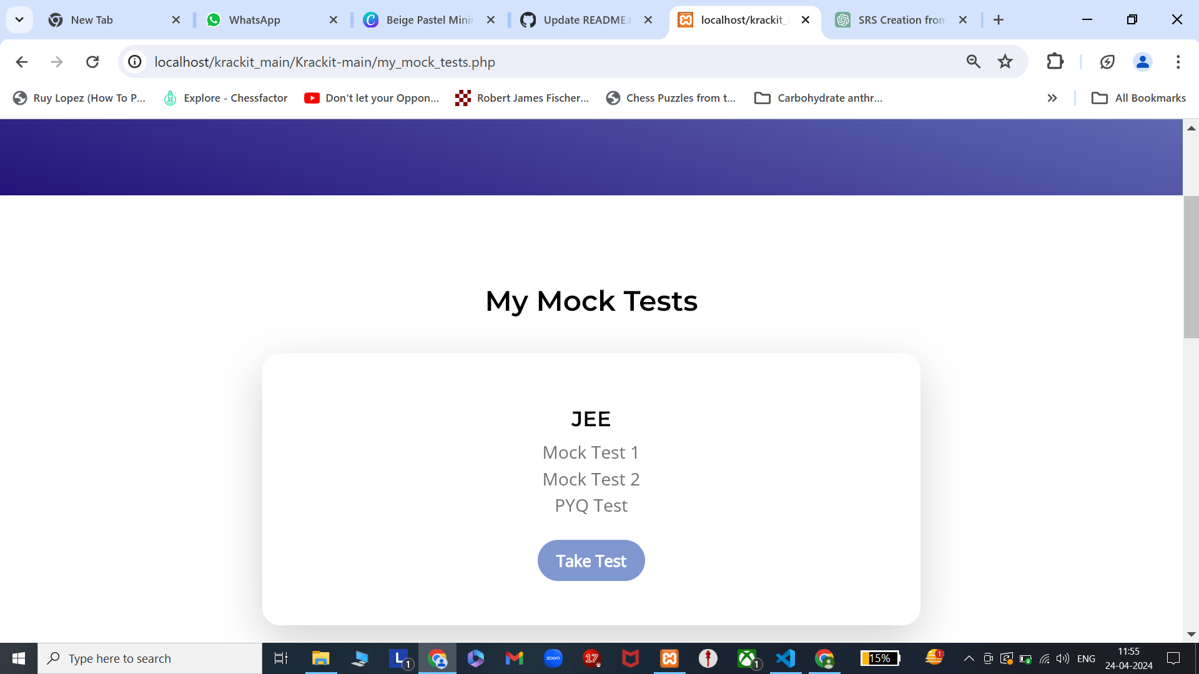

Slide 26
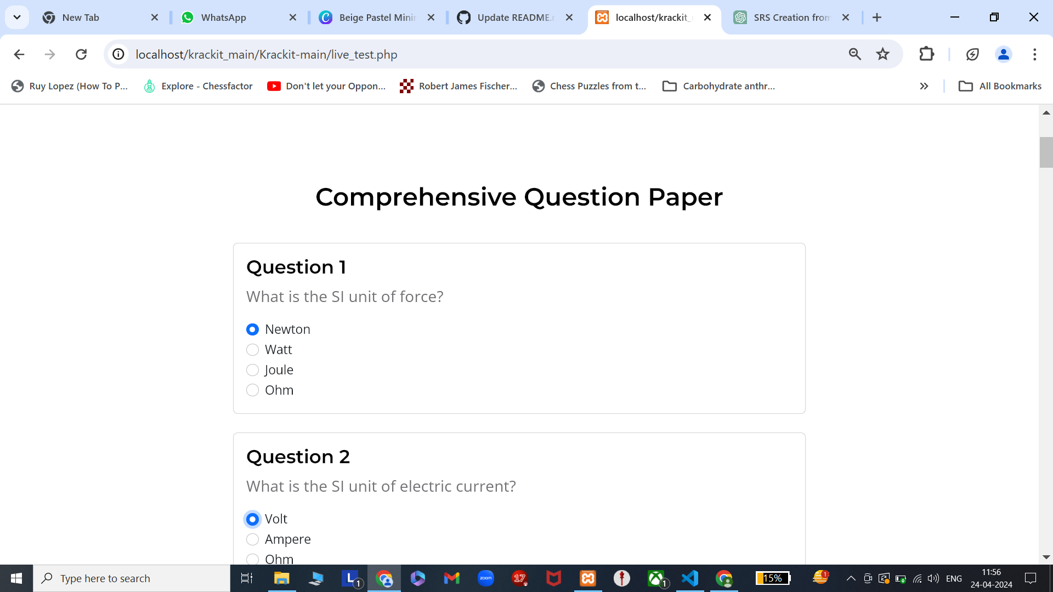

Slide 27
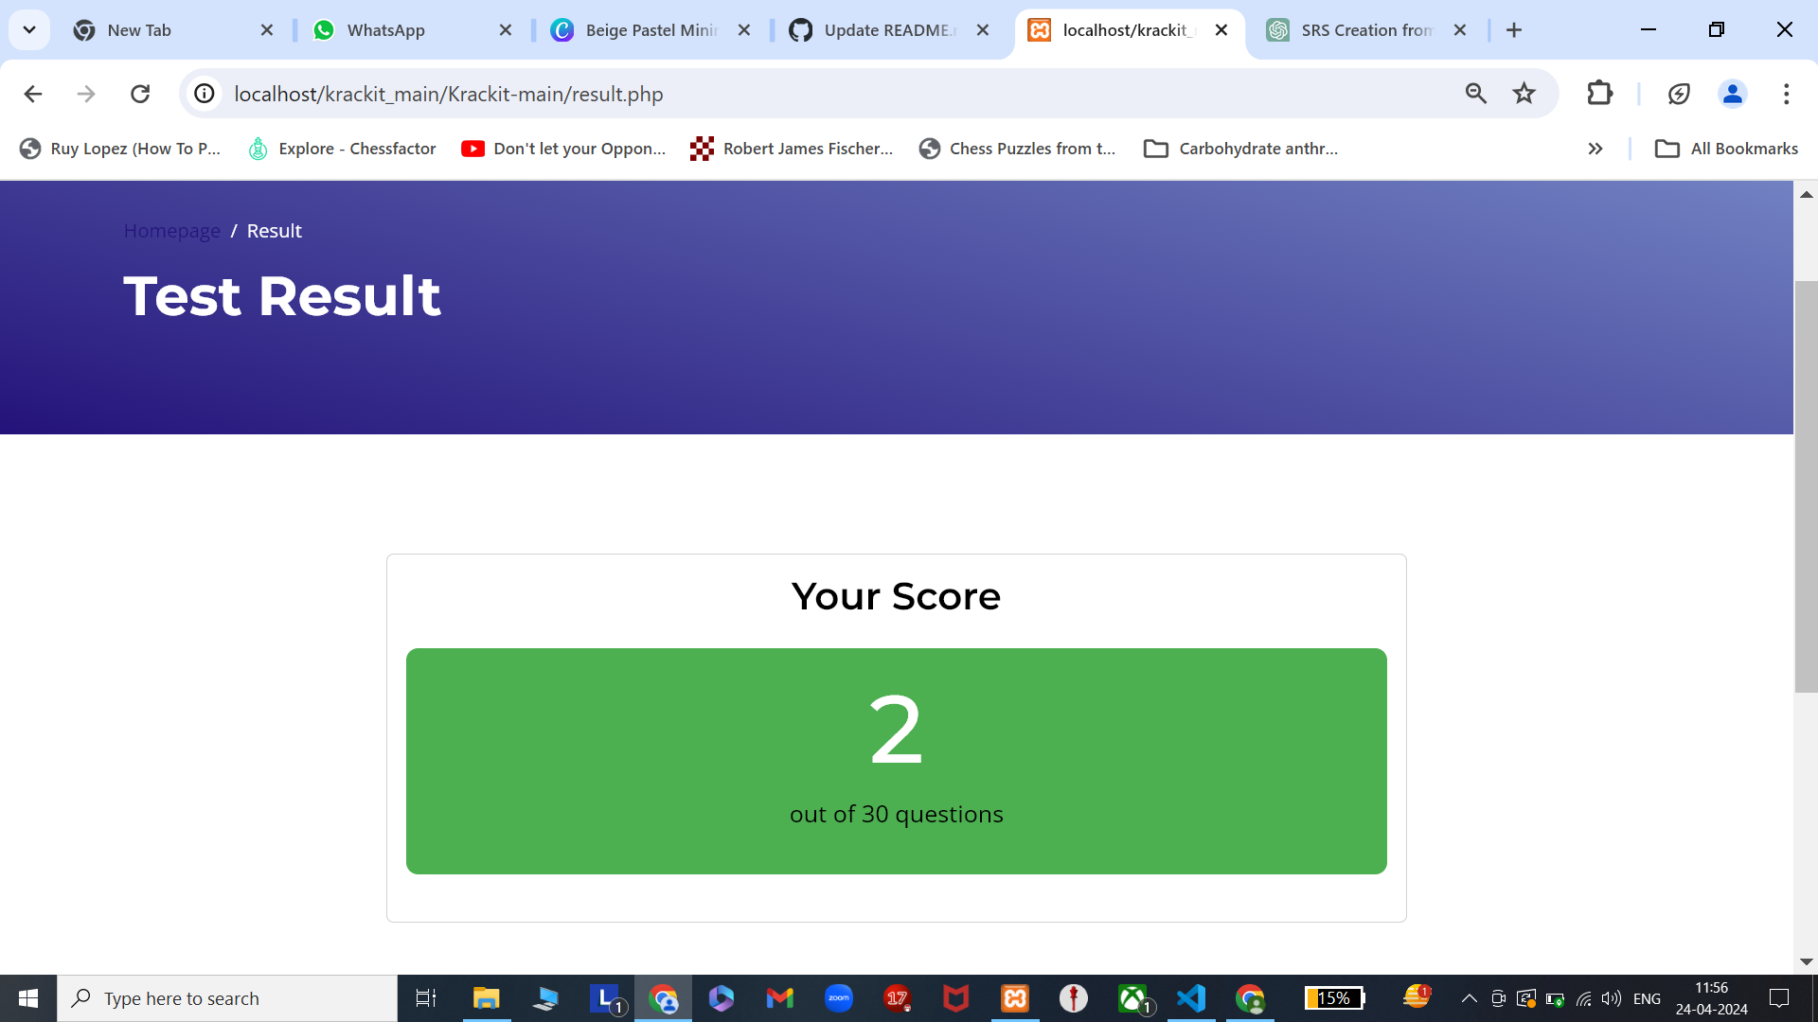

Slide 28
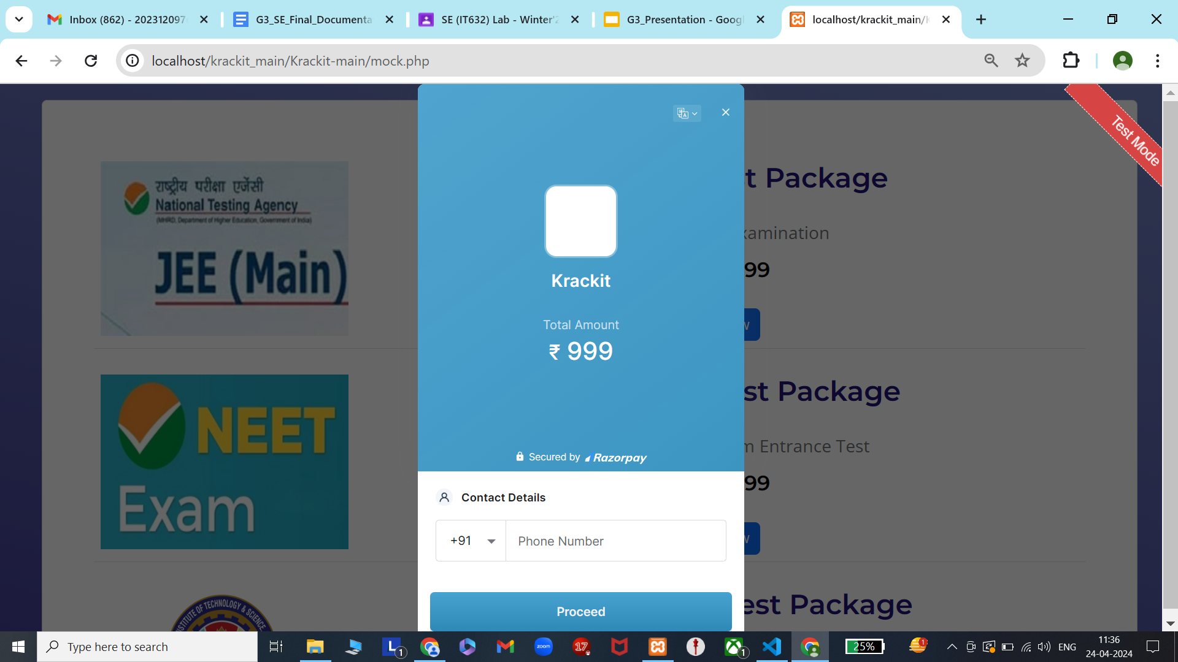

Slide 29
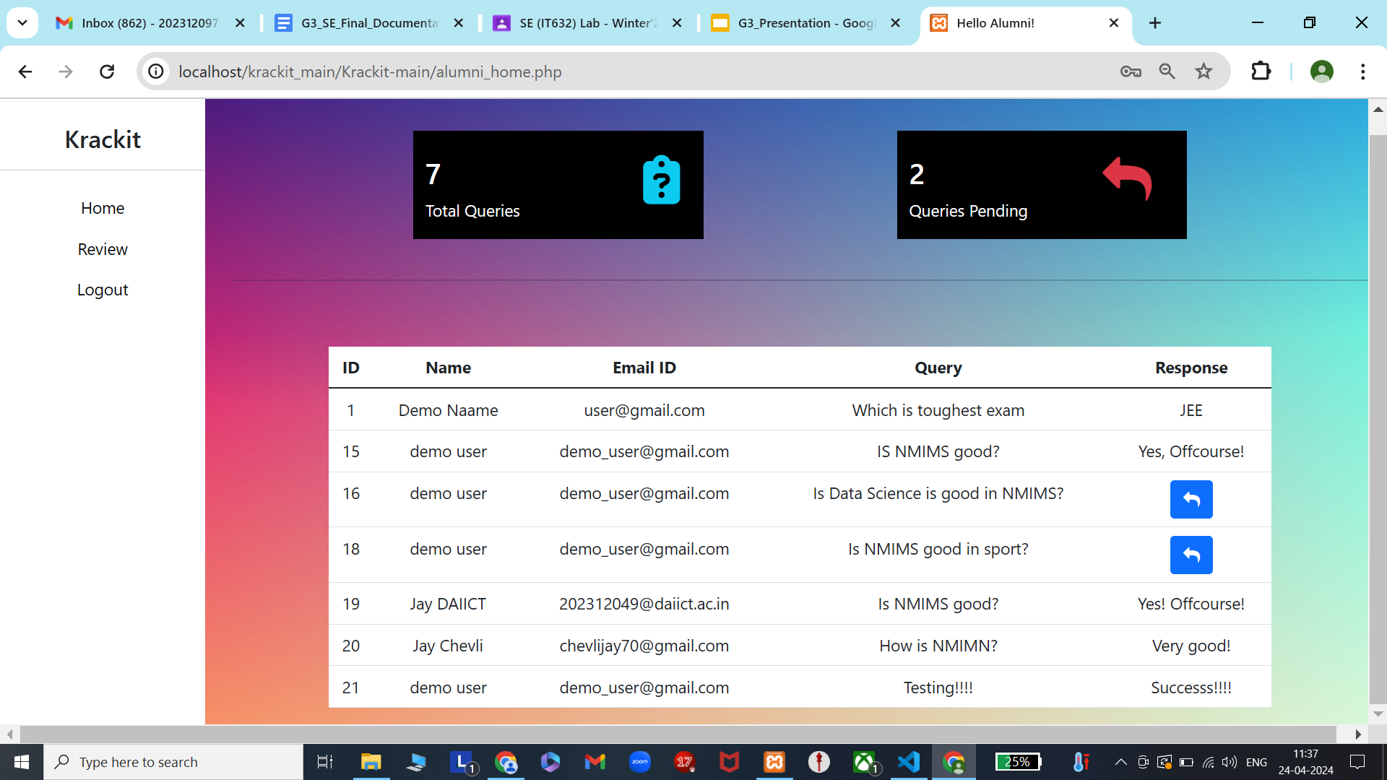

Slide 30
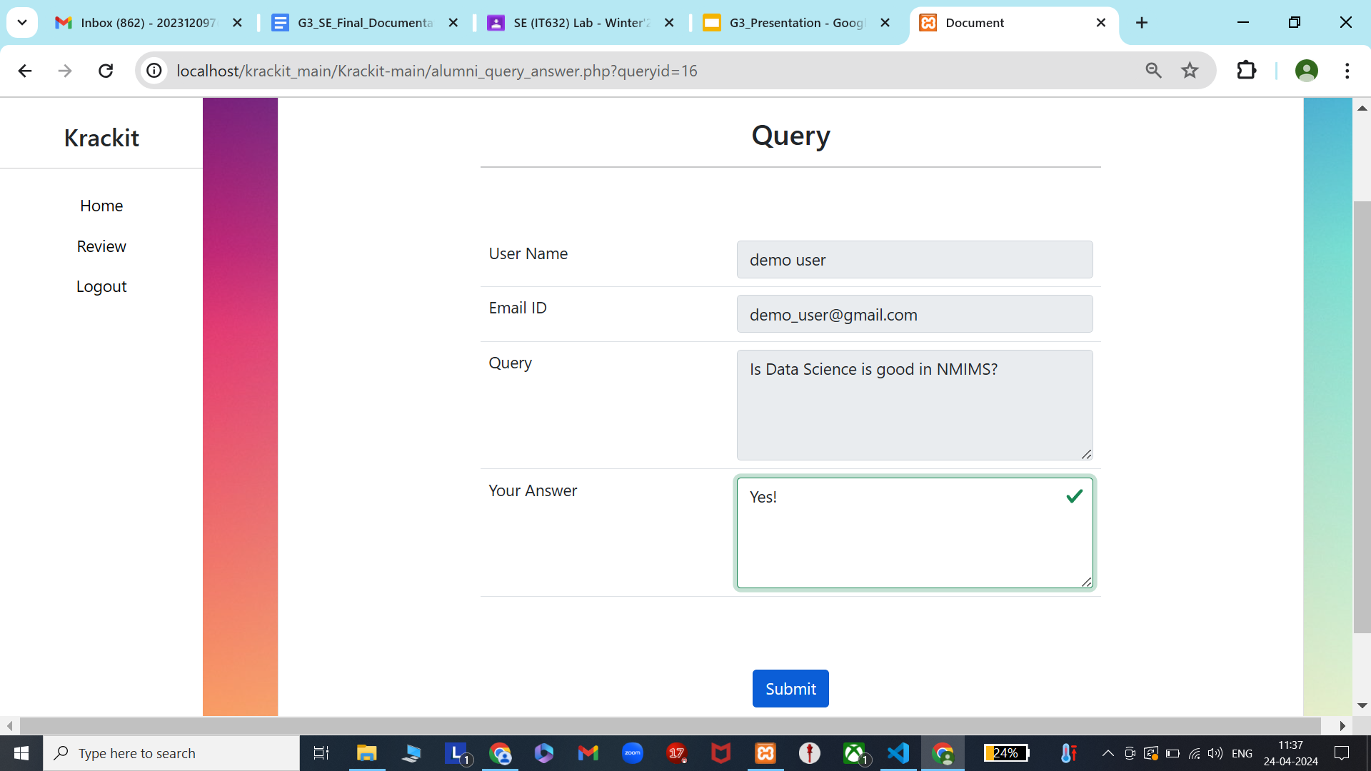

Slide 31
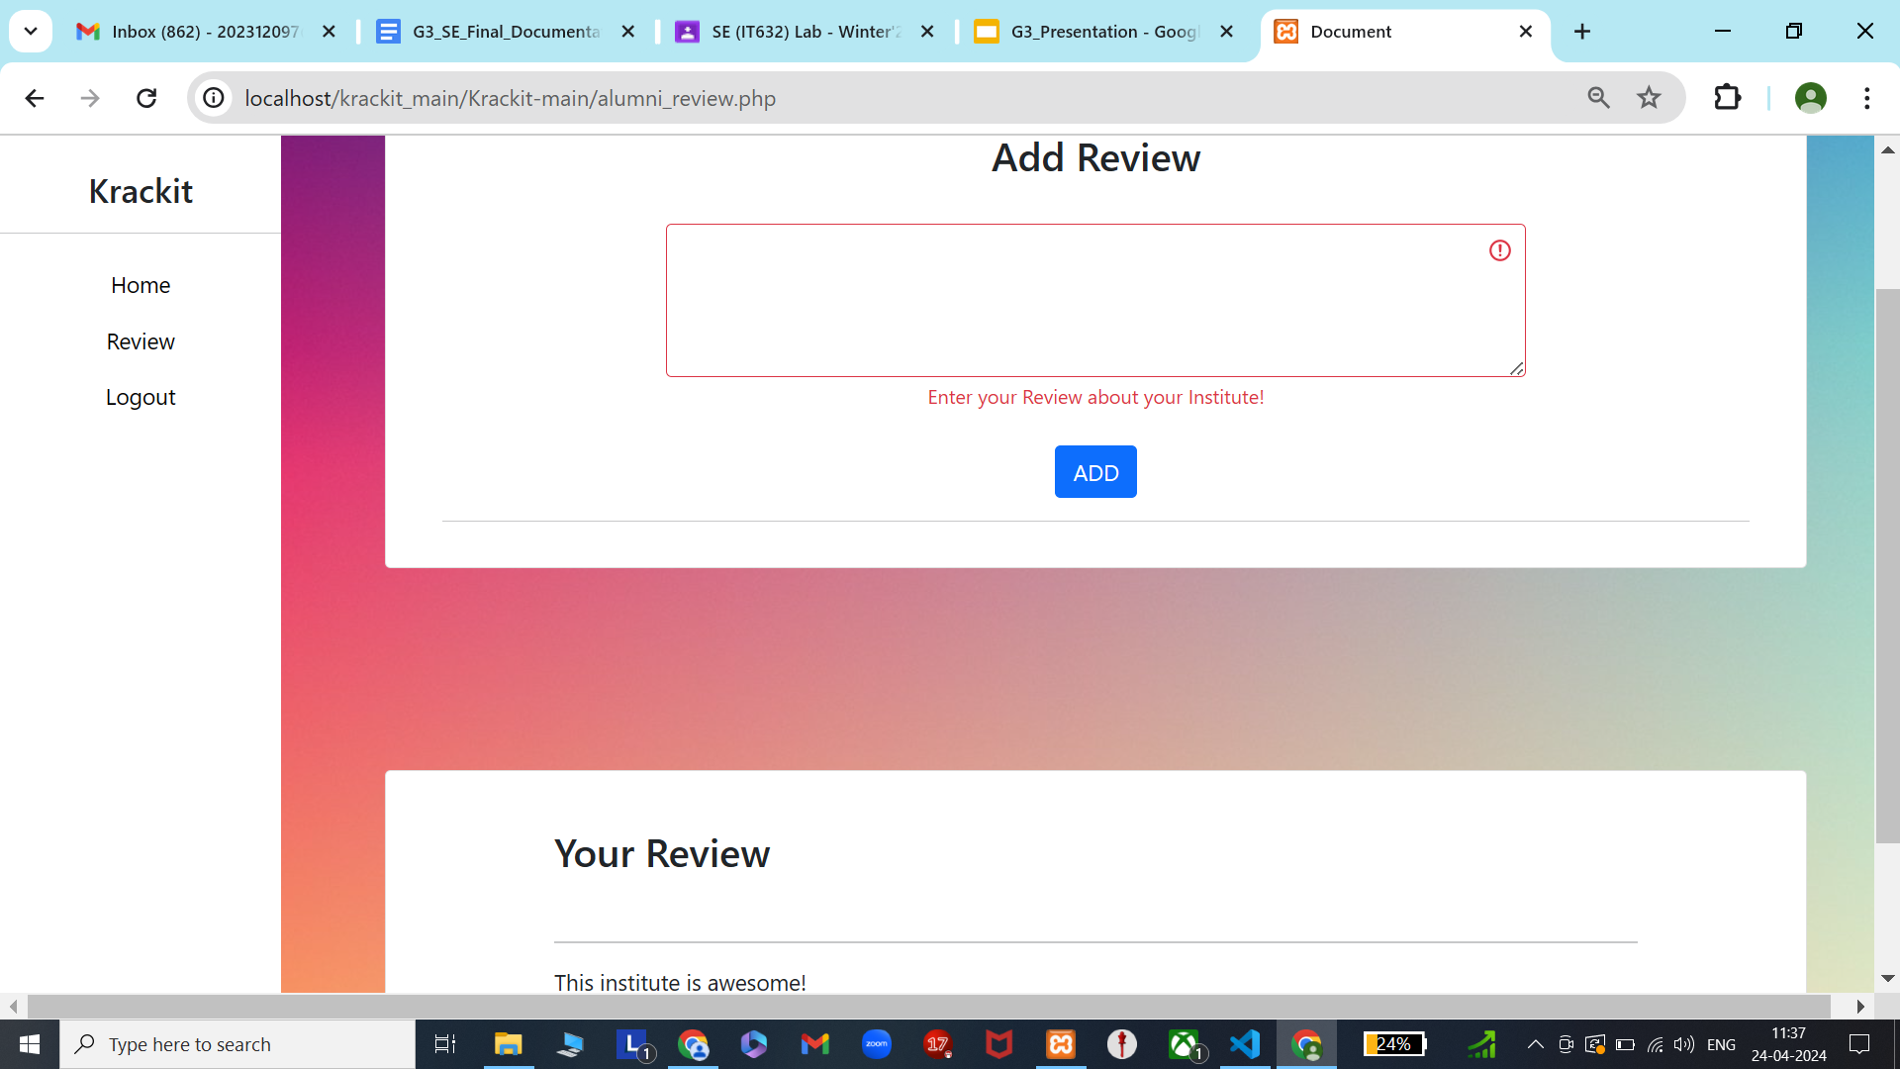

Slide 32
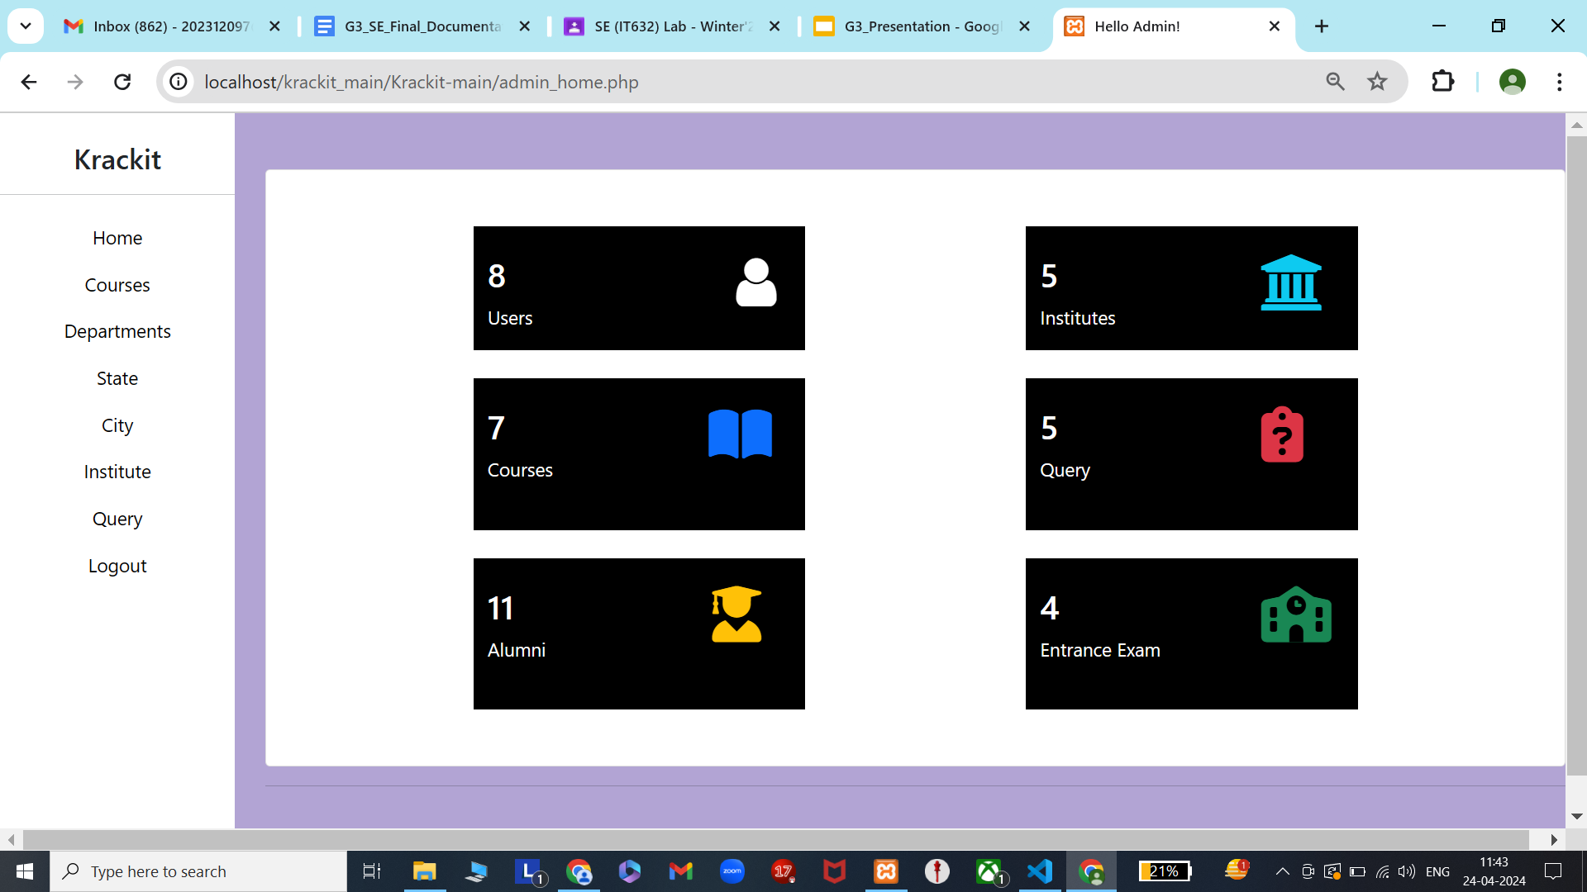

Slide 33
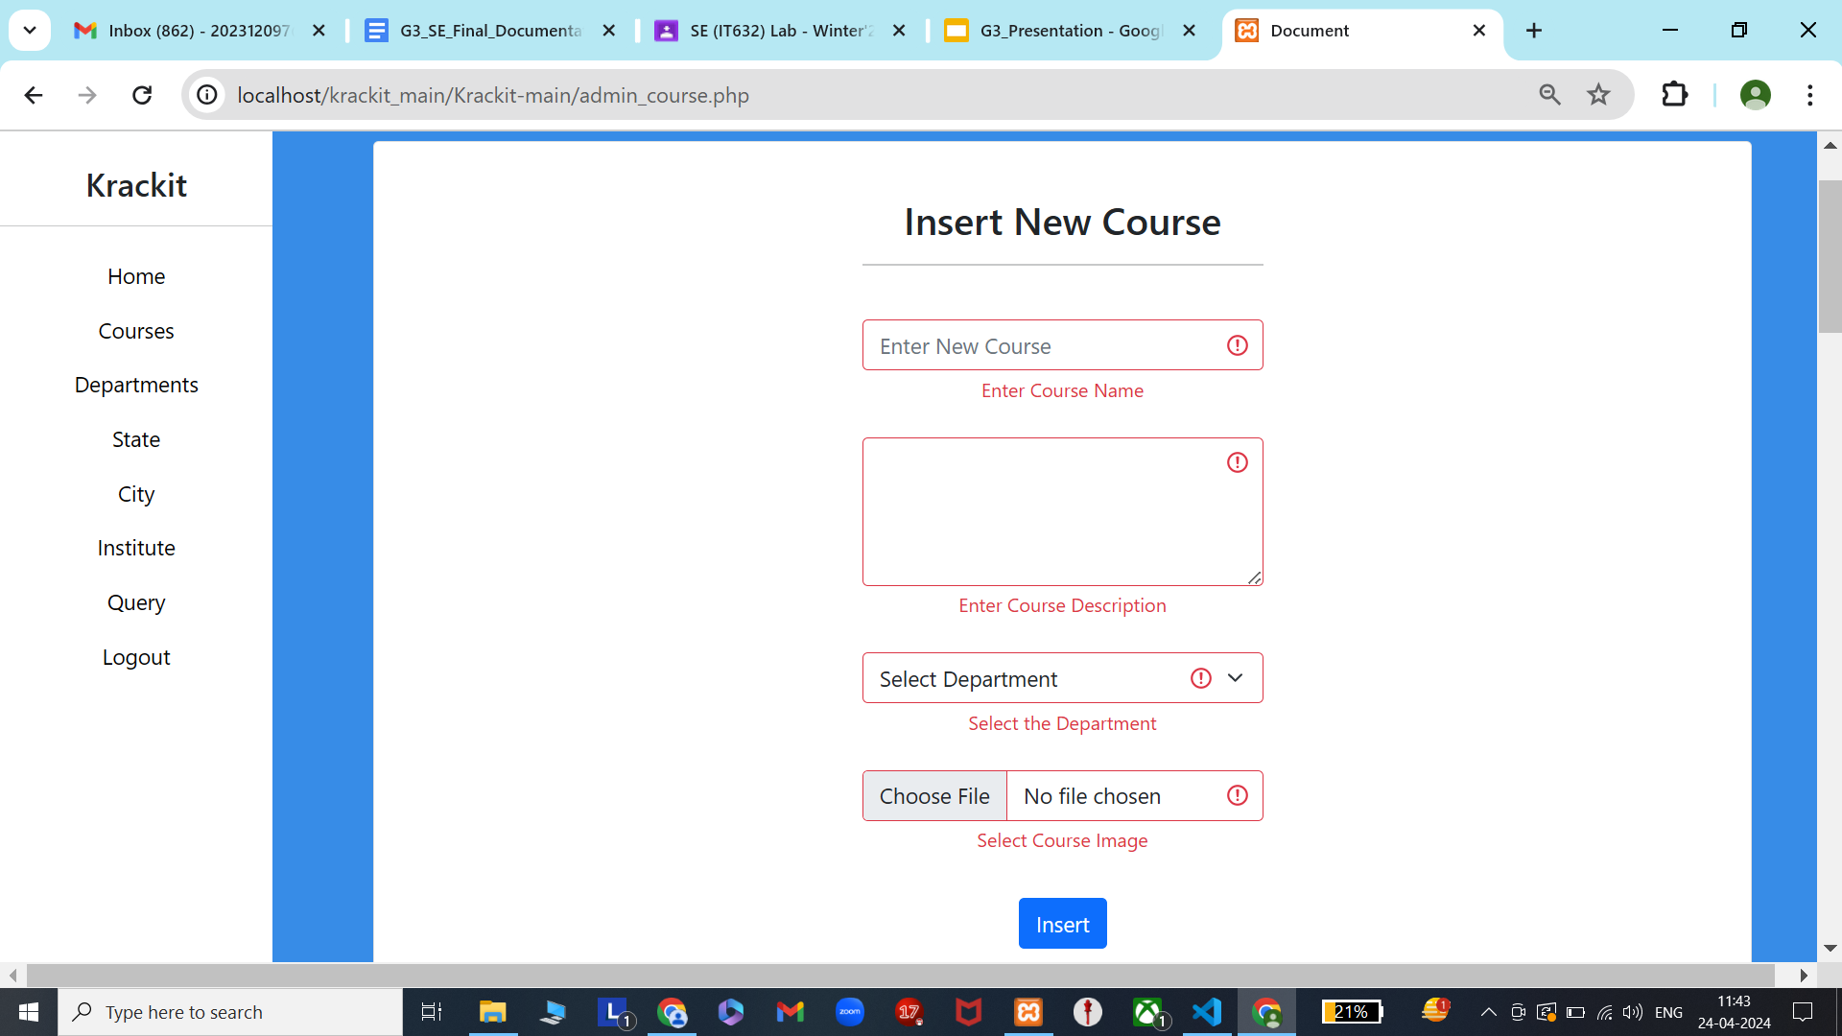

Slide 34
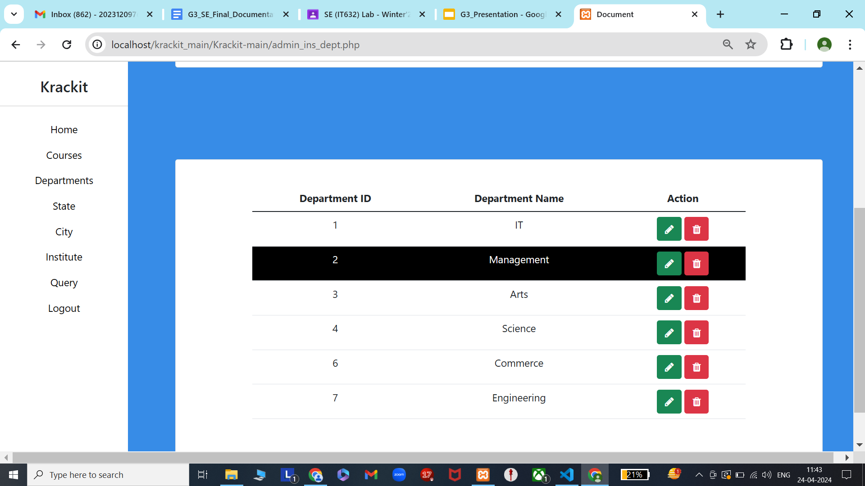

Slide 35
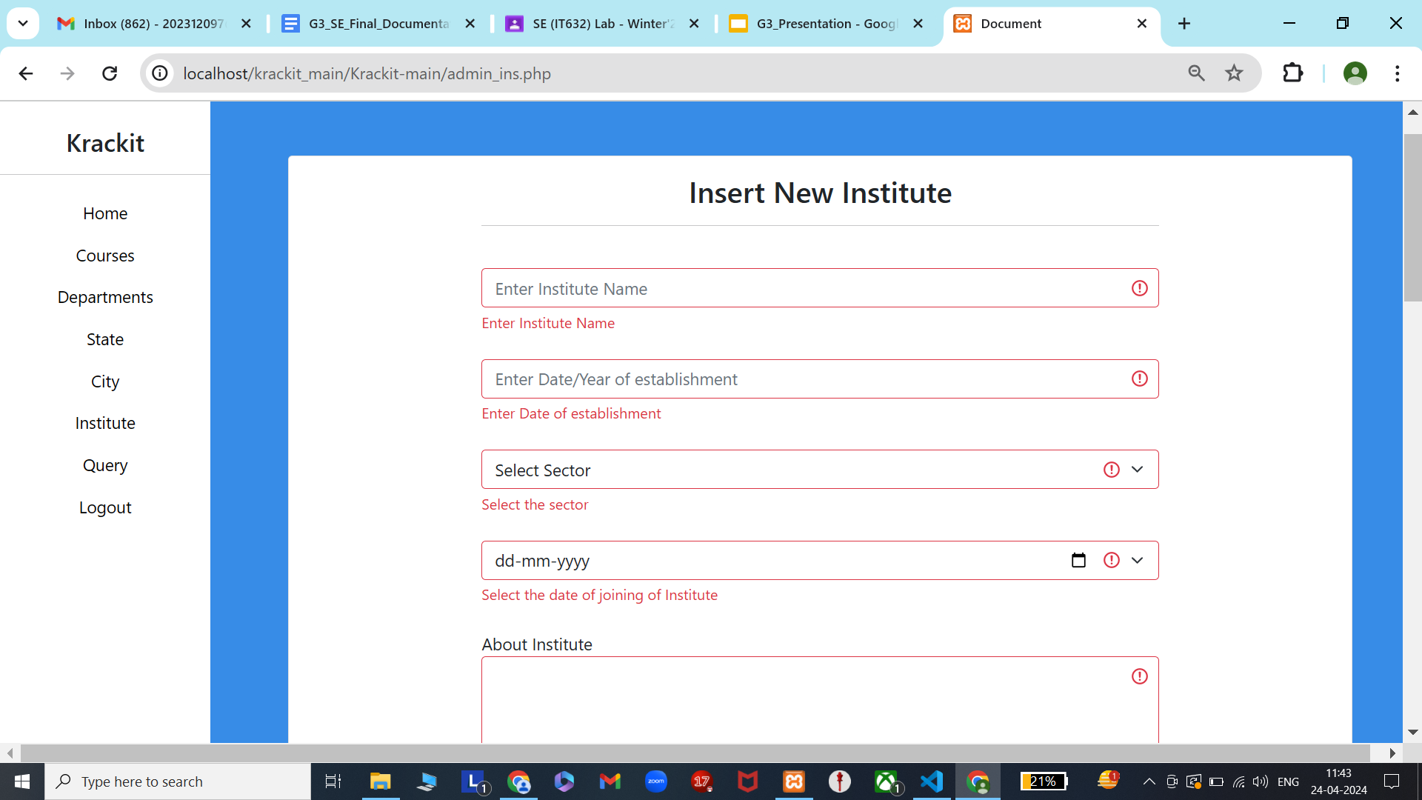

Slide 36
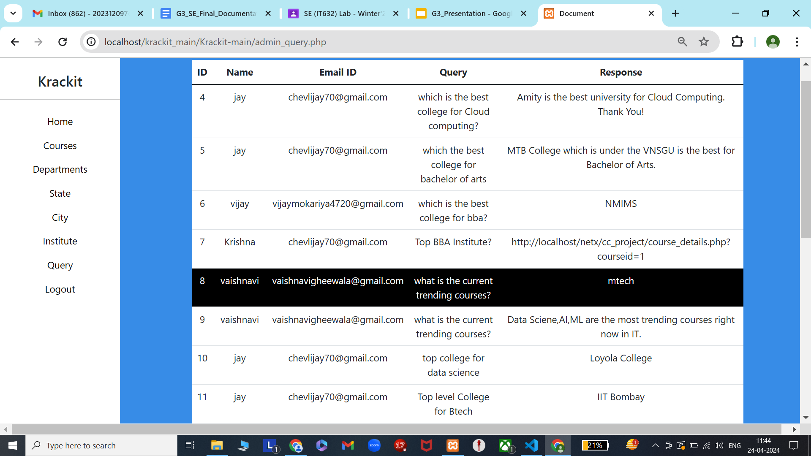

Slide 37
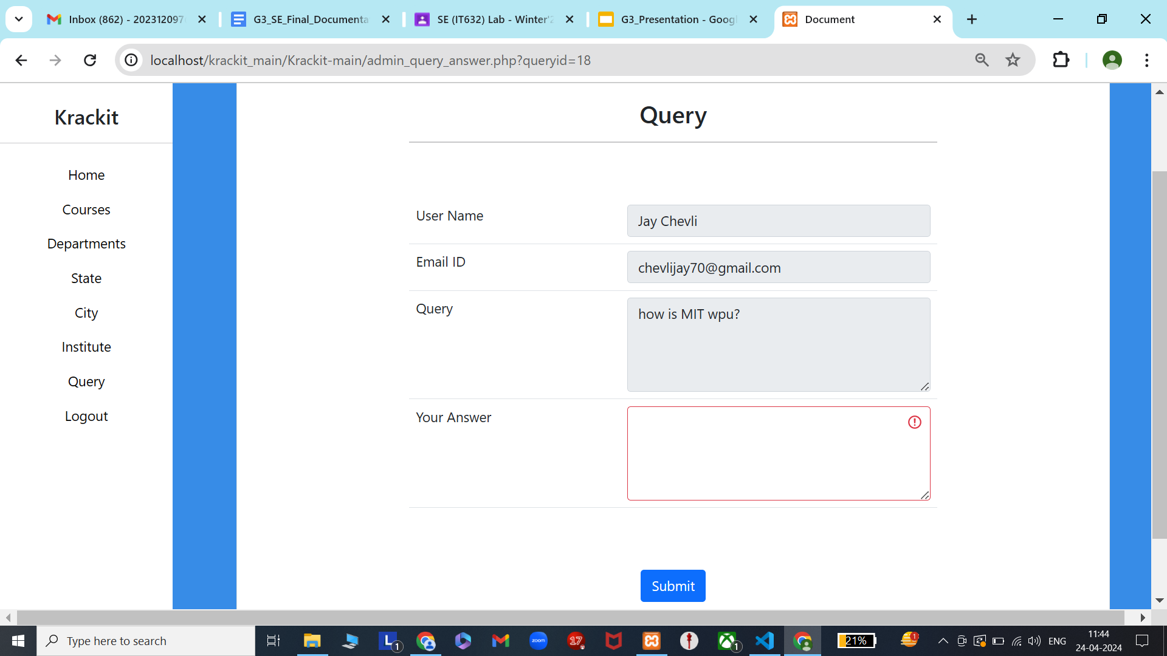

Slide 38
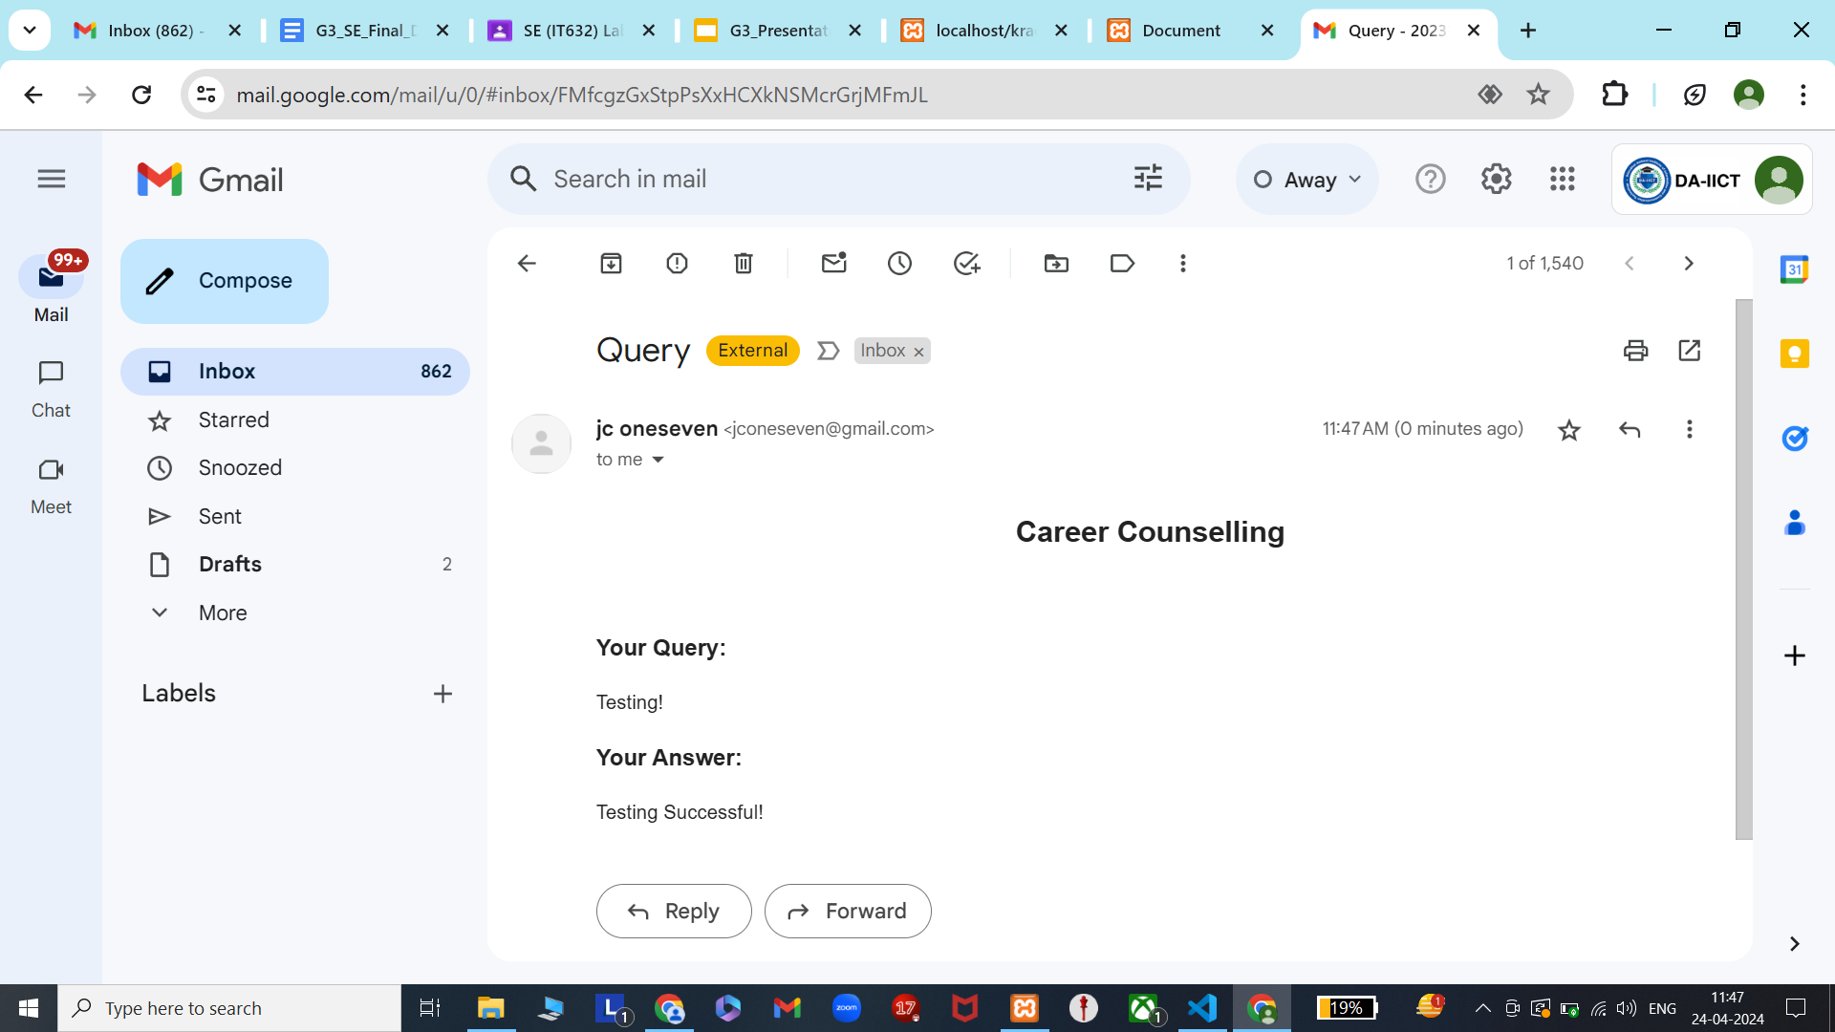

Slide 39
Lessons and Takeaways
Teamwork using Taiga:
Effective communication and leveraging individual strengths.
Problem-Solving:
Adaptability and creative solutions.
Time Management:
Prioritization and meeting deadlines.
Continuous Improvement:
Feedback incorporation and skill enhancement.

Slide 40
Achievements
Successful Completion:
Developed a fully functional website meeting project requirements.
Effective Collaboration:
Demonstrated strong teamwork and coordination among team members.
Valuable Experience:
Gained valuable skills and experience in web development through project execution.

Slide 41
Mistakes
Project Scope Management:
Overextending project scope, leading to resource allocation challenges and timeline delays.
Unorganized source control:
Underestimating the importance of git for source control and faced challenges doing it manually.
Insufficient Testing:
Lack of comprehensive testing leading to discovery of few bugs later.

Slide 42
References
collegedunia.com
W3schools.com - Bootstrap
Careers360.com
Github – Razorpay(PHP Community)

Slide 43
Thank You

